Slide 1




US Based crowdfunding platfrom
KICKSTARTER
DASHBOARD
ANALYSIS
Presented by group 3

Slide 2






GROUP 3
Team Members
Miss. Yamini L
Miss. Pratiksha Suresh Jaulkar
Mr. Himanshu Sanjay Patil
Mr. Mohammed Hameen
Mr. Pallapu Saikiran
Mr. Rupesh Vilas Ravate
Mr. Dip Khara

Slide 3
﻿Table Of Contents
1
Project Topic
2
KPI Overview
3
Data Model Challenges
4
Final Dashboard
5
Analytical Suggestion

Slide 4
About Kickstarter
Kickstarter is a US based online crowdfunding platform founded in 2009 they offers project creators to raise there fund faster way by connecting with broad audience of project backers, since there launched they have been funded 2,49,258 projects successfully.

Slide 5

﻿What is Croudfunding
Crowdfunding stand as an unique fundraising Method that reshaped the landscape of project financing which helps to gather capital for projects by collecting donation from a broad audience, this are called backers These backers play a primary role in supporting creators to turning their ideas or projects into reality.

Slide 6
Why Backers Support
Backers support projects in crowdfunding because they believe in the idea or cause, aligning with the project's goals. The sense of community and engagement with the creators fosters a personal connection, making backers feel invested in the project's success. Crowdfunding often offers exclusive rewards or early access, incentivizing backers to contribute. The opportunity to be part of something innovative or meaningful motivates backers to lend their financial support. Additionally, backers may see crowdfunding as a way to influence and contribute to projects that might not receive traditional funding.

Slide 7
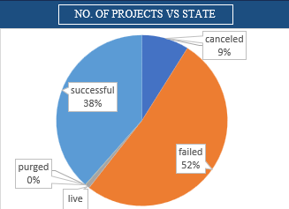
Outcome wise no of projects
This KPI indicates that outcome of projects and as we can see failed rate of the projects is more than +50%

Slide 8
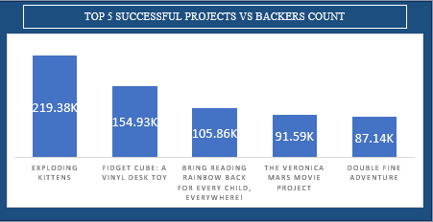
Successful Projects by Backers
This KPI shows the top Projects based on max backers count for a single project

Slide 9
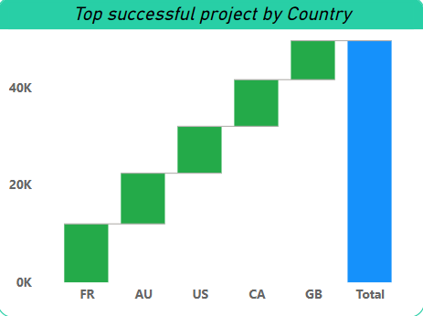
Successful Project by Location
This KPI shows top successful projects country wise

Slide 10

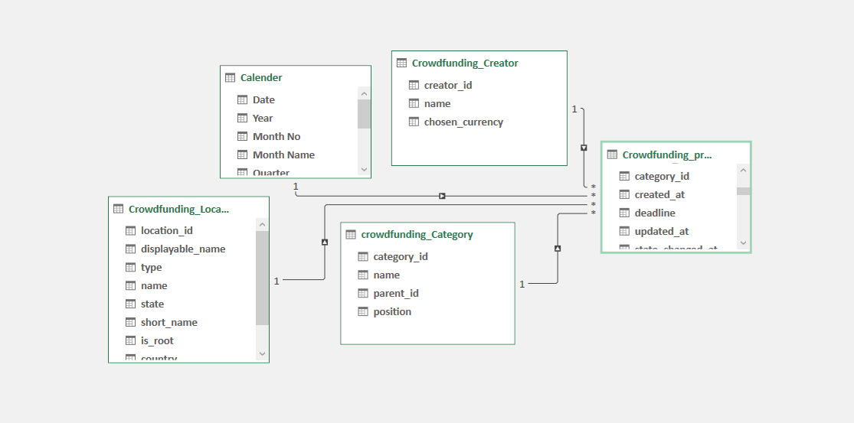

Data Model Challenges
Epoch time to human readable time conversion
Calendar Creation and connecting with data

Slide 11
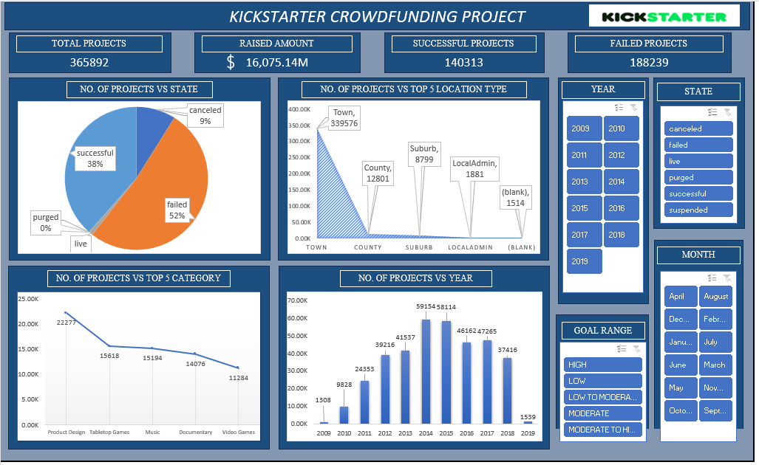

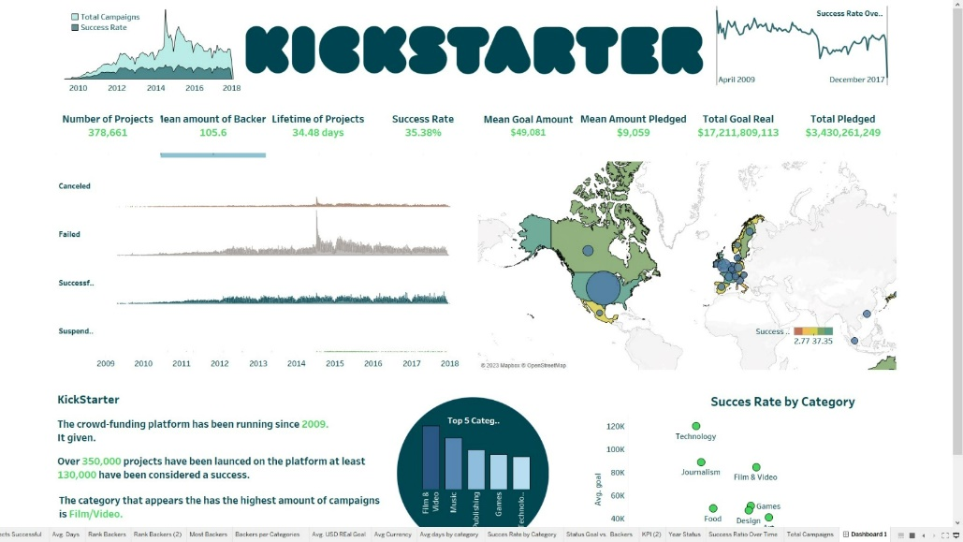
Dashboard Showcase
Excel
Tableau

Slide 12
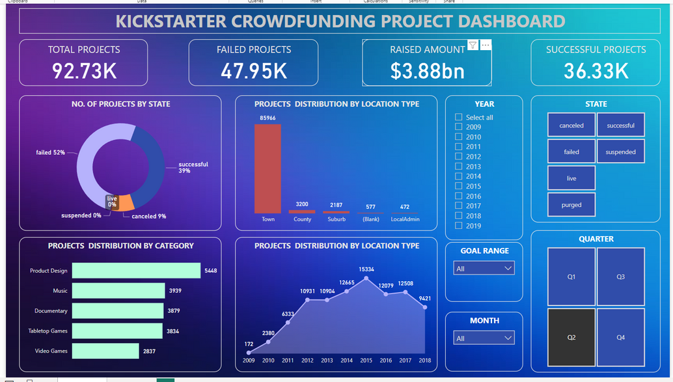
Dashboard Showcase
PowerBI
Excel

Slide 13

Dashboard Showcase
Tableau
PowerBI

Slide 14
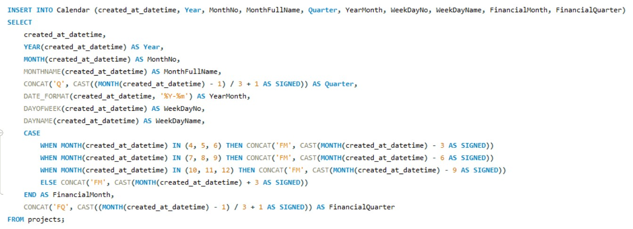
SQL

Slide 15
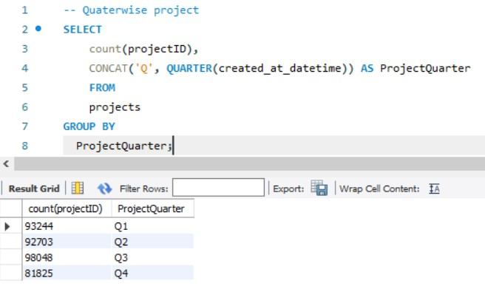
SQL

Slide 16



Analytical Suggestion
Brand should focus on improving the status of the project cause there is more than 50% failed projects.
Brand should aware backers related others project category.
brand should launch a paid services for promoting their projects.
Brand should observe and rank project creators based on projects and publish report time to time.

Slide 17
﻿THANK YOU

